Slide 1
CSSE 513 Intelligent Systems – How smart can computers be?
Steve Chenoweth
Dept of Computer Science & Software Engineering
Web site: http://www.rose-hulman.edu/~chenowet/
Email: chenowet@rose-hulman.edu
Week 1, Part 1:
What is AI?
Why’s it important to us?
What are the limits?
How will we learn more about it?

Slide 2
Artificial Intelligence --
My background – cooperative systems, like the handoff in this background!
It makes you realize you have to think like the other humans – in this case, I’m working on Chinese.
Computers working together
Computers and humans
Humans and humans!

Slide 3
Artificial Intelligence --
I use this same lecture in Catapult!
What is it? First a joke about the word “Artificial”…
Hey Dave, what are those big hands behind us doing?
Pay no attention, Bob, – they are just artificial!
The Original Catapulting Team…
Notes:
Image of catapulters from xenophongroup.com/ montjoie/ngp_arty.htm

Slide 4
What is Artificial Intelligence (AI)?
Machine Intelligence – things we’d call smart, only computers, robots, etc. do them.
A couple of smart early humans with a smart early machine
Notes:
Picture of Oppenheimer and von Neumann from http://www.aip.org/history/esva/catalog/esva/Oppenheimer__.html

Slide 5
What is Artificial Intelligence (AI)?
Or, something machines and we do together – We do them, with their help – like the relay handoff in this background! Example –
You set up a search problem.
The computer runs for a while and solves it.
Like in the following ….
Like Google helping you find information.
Notes:
Relay image from http://news.bbc.co.uk/sportacademy/bsp/hi/athletics/rules/track/html/relay.stm

Slide 6
The world of chess
How do you beat Gary Kasparov at chess?
In 1997, IBM’s “Deep Blue,” a program set up and tuned very specifically for chess by humans.
Not very cooperative from Gary Kasparov’s viewpoint, of course!
Notes:
See, for example, www.chessbase.com/ newsdetail.asp?newsid=255

Slide 7
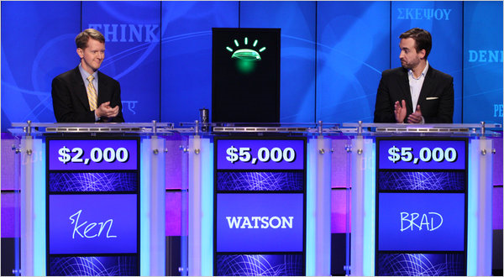
How about Jeopardy?
IBM’s “Watson” beat the two best human Jeopardy players in 2011.
A wide variety of subjects and response subtleties.
Only occasionally did “Watson” give stupid-sounding answers.
Notes:
Image from http://www.nytimes.com/2011/02/17/science/17jeopardy-watson.html?_r=1.

Slide 8
The question always comes up – What do we mean by “intelligence”?
What would you say?

Slide 9
The question always comes up – What do we mean by “intelligence”?
Ability to do certain things that people do?
Ability to do things “smart” people do?
Ability to replace people doing things?
Flexibility?
Emotion?
Spirituality?
Notes:
Cartoon from www.cyberlove101.com/ humor.htm

Slide 10
The question always comes up – What do we mean by “intelligence”?
How about: Ability to fake people into thinking it’s human?
"Anyone would have taken it for a live human being“
- here we have one of the key phrases.
Notes:
Quote and illustration of Tiktok, the Machine Man in Frank Baum’s Ozma of Oz (1907), both from www.stanford.edu/group/ SHR/4-2/text/mazlish.html

Slide 11
How about this interpretation?
Something is intelligent if it gives good answers you weren’t expecting.
Or, that have to be explained or interpreted for you to get it.
Or, that shed new insight on a subject you are interested in.
Or, provide new ways to deal with something.
Or, just surprise you…
Notes:
Image of Jon Stewart from http://dms-blog.com/tag/huh/

Slide 12
Which brings up – Are people always intelligent or even correct, even as a collective group?
Depends…
Consider the Ames Window…
Some problems are “hard” for us.
Machines may be smarter already!
Notes:
The video of this is from www.richardgregory.org/ experiments/ , also available at https://www.youtube.com/watch?v=tc_LqIaO2b8. .

Slide 13
Some problems seem to remain “hard” for machines…
Talking like people, with people… E.g., the Turing Test (see http://cogsci.ucsd.edu/~asaygin/tt/ttest.html )
How long before a machine could figure out, without being specifically told, the difference between these statements? –
Time flies like an arrow, but
Fruit flies like a banana.
Notes:
Fruit fly from http://genome.pfizer.com

Slide 14
Others, machines are now good at…
Say – Constraint satisfaction problems. How would you write R, G, or B on each region, as required

Slide 15
One solution to this problem –
There are other possible ways.
(I wonder how many.)

Slide 16
Another example of constraint satisfaction –
These examples are all from Russell & Norvig’s book – which we use for undergrad AI.
They involve AI “search” – Here’s another example – finding the assignment of digits to solve this math puzzle.

Slide 17
AI plays with some very interesting things –
Very precise things – deep mathematics, like the foundations of first order logic.
This lets us represent the logic of our thinking
Machines can try to duplicate our analysis
Very fuzzy things, like fuzzy logic and “heuristics”
This lets us guess what to do when we aren’t sure
The machines can similarly try out hunches
Yes, it’s the Zojirushi NS-MYC10 Micom Fuzzy Logic 5.5 Cup Rice Cooker and Warmer, available at Amazon.com

Slide 18
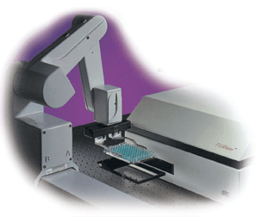
Some major areas of AI
Search and planning (CSP is part of this)
Big data!
Game playing
Speech understanding
Vision
Machine learning
Agents and wizards
Fuzzy logic
Neural networks
Robotics
A Beckman-Coulter medical research robot in action.

Slide 19
Why is AI important to us?
Present – AI is buried in lots of things we use:
Ads from Google
Smart tools – even toasters
Smart web search & commerce – like Amazon.com
Cool games & toys – like Aibo & Asimo. 20 Questions?
Help desk helpers
Future – Intelligent Machines are likely to grow in value, indefinitely…
What will they be like 40 years from now?
Interesting to get in groups of 3-4 and discuss for 5 min.
Upper image of Sony Aibos at play. Lower image is from Fritz Lang’s 1926 Metropolis, the original futuristic movie starring robots.

Slide 20
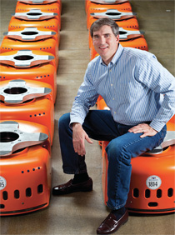
AI planning is a current hot-topic
E.g., Kiva Systems warehouse systems.
See http://www.kivasystems.com/resources/videos/.
Story of how they developed the system.
See https://www.alumni.hbs.edu/stories/Pages/story-bulletin.aspx?num=843.

Slide 21
There are lots of new problems just waiting for AI to tackle them…
Here’s one long-term example – “The Coming Superbrain”
From the New York Times, May 23, 2009.
Quick question – Is Google “It”?
Notes:
http://www.nytimes.com/2009/05/24/weekinreview/24markoff.html

Slide 22
Q: How do you know what people don’t buy?
A: Ask Facebook!
But, it’s going to take some AI to dig this information out!
Parsing natural language input from all the users…

Slide 23
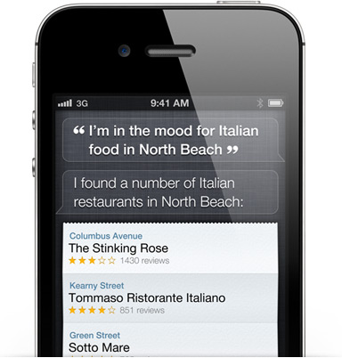
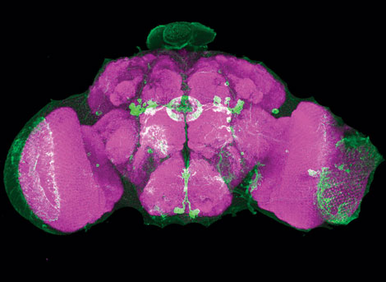
AI – What are the limits?
Apple’s Siri – an example of a useful “android” personality
A Grand Challenge – Reverse engineer the brain!
Notes:
Pictures from http://www.apple.com/iphone/features/siri.html and from http://spectrum.ieee.org/biomedical/ethics/reverse-engineering-the-brain.

Slide 24
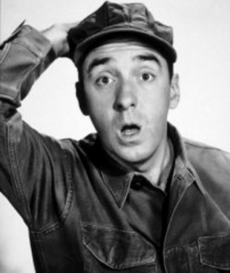
How will we learn more about it?
That’s what this course is about.
It’s a surprise!
And therefore intelligent.
As usual, you’ll try things on your own.
And surprise the rest of us!
We’ll focus on one specific area more than others – Machine Learning.
Awareness of other areas of AI.
And their practical uses.
Like “search,” say.
Notes:
Gomer Pyle image from http://thesunbreak.com/2011/04/27/eddie-vedder-and-dave-grohl-play-surprise-encore-at-mike-watt-show/

